Slide 1
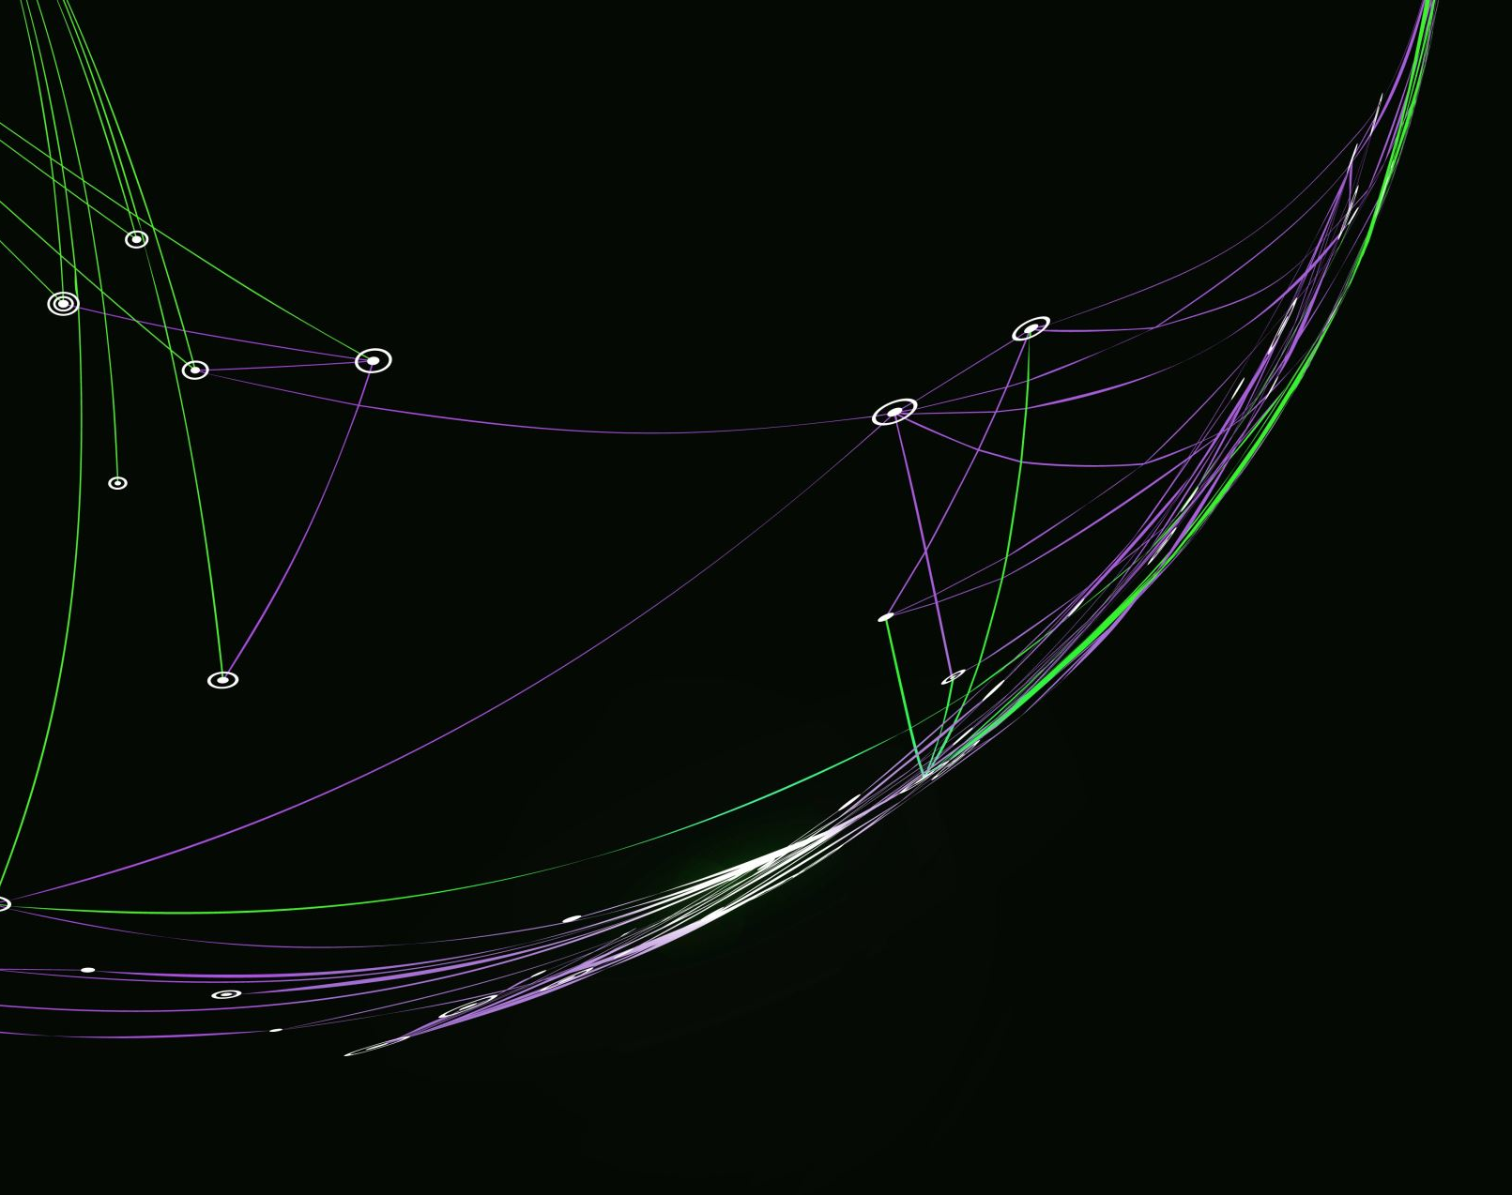
Task Management System
Shadarien Williams
Instructor: Dr. Mubarak Banisakher
Course: FA-COP-2939-93453

Slide 2

OUTLINE
The purpose of this project is to develop a Task Management System that allows users to organize, prioritize, and track their tasks efficiently. The system is designed to help individuals and teams manage their workflows by providing features such as task creation, categorization, due dates, priority levels, and status tracking. The application will be intuitive and user-friendly, enabling users to maintain productivity and ensure that all tasks are completed on time.

Slide 3

BACKGROUND
The idea for this project stems from the need for a simple yet effective tool to manage tasks and projects. Many existing task management applications are either too complex or lack the necessary features for effective task tracking. This project aims to bridge that gap by providing a balanced solution that is both easy to use and comprehensive enough to meet the needs of various users. A prime example of this idea is the Canvas platform. The platform contains a to-do list section however, it's only available in the mobile version. I wanted to make a platform that was universally accessible and completely customizable.

Slide 4
DEVELOPMENT PROCESS
Document Requirements
Design and planning
Implementation
Testing
Deployment and Final Review

Slide 5

REQUIREMENTS

Slide 6
Requirements
Python 3.x
Django
Modern Web Browser (Chrome, Firefox, Edge, etc.…)

Slide 7

Design and planning

Slide 8
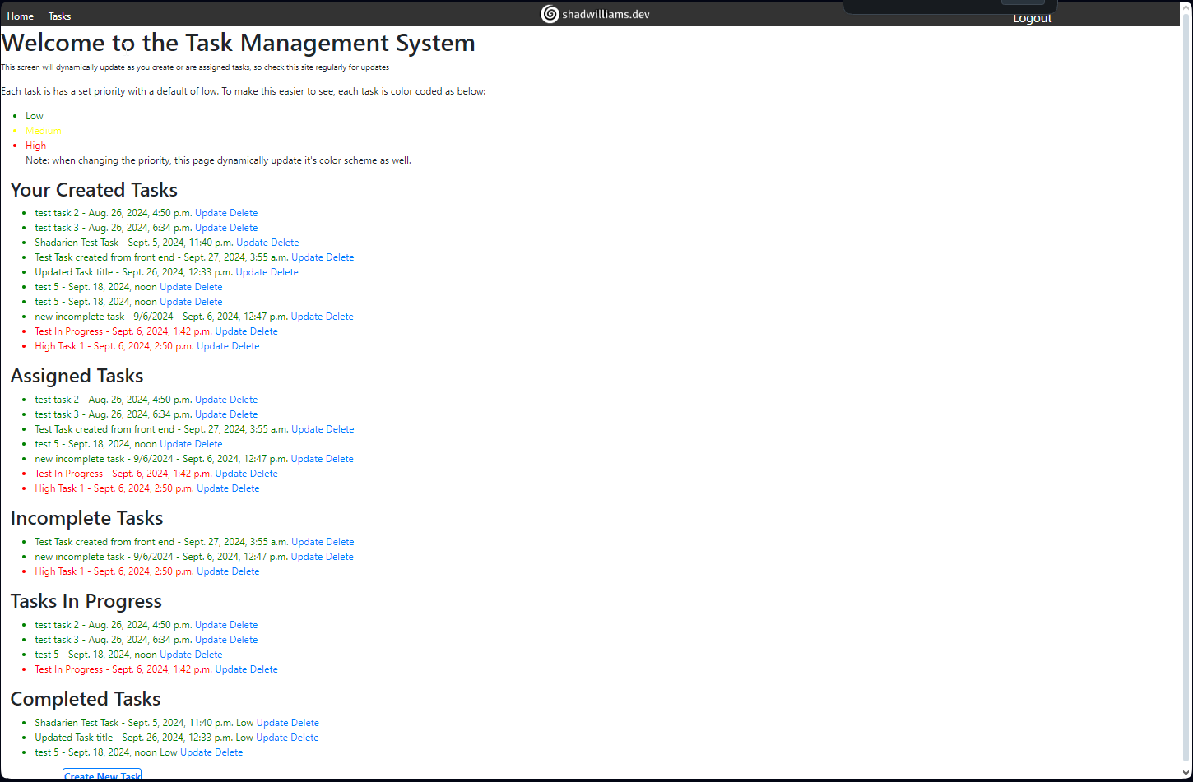
Main Page
Users can see their assigned tasks with a “Create new Task button”.
Note, login is required to view this page.

Slide 9
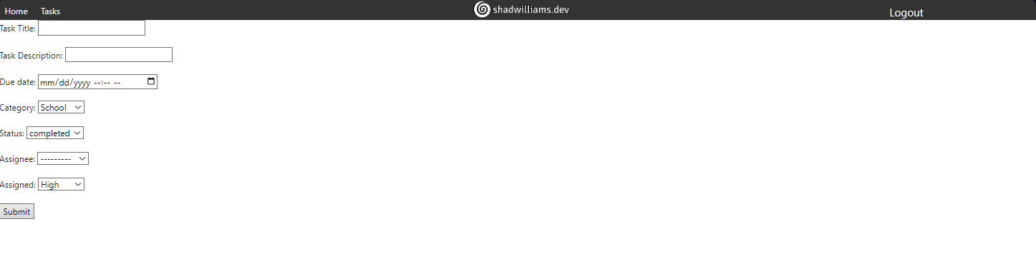
Task Creation Page
A form to input task details such as a title, description, due date, and assignee.
Only users who are not “managers” are able to be selected in the assignee dropdown.

Slide 10
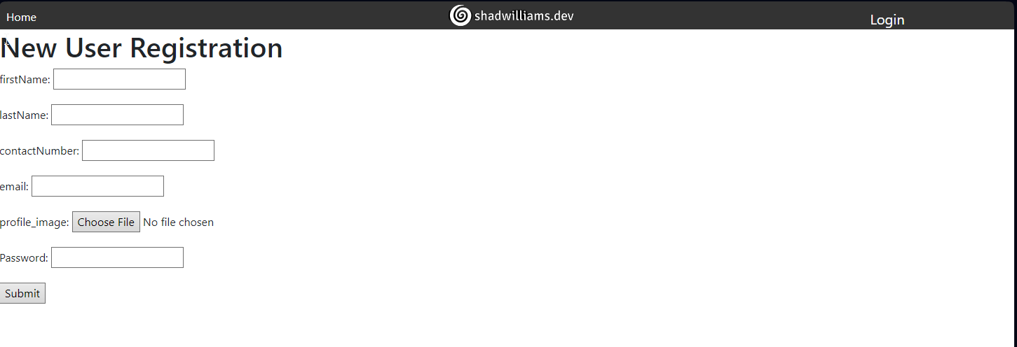
User Registration
Enables new users to register at the time of login.

Slide 11
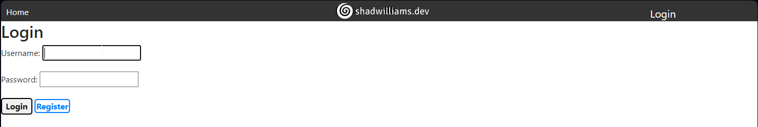
Login Page
Allows users to authenticate

Slide 12
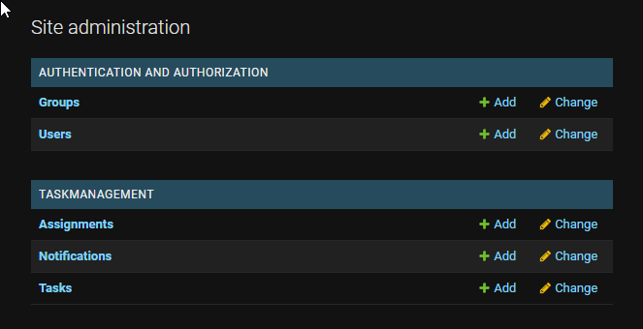
Admin Panel
Admin panel allows the superuser to add, create, read, and delete the listed objects on the server

Slide 13
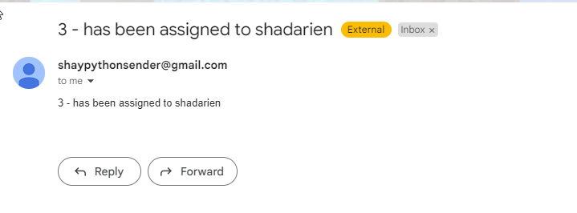
Email / Notification System
Email notifications are delivered with the template of {task_id} – has been assigned to {users name}
Replying is not enabled at this time

Slide 14
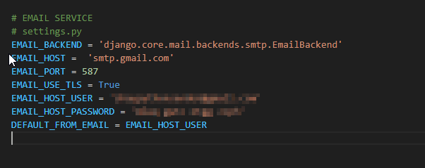
Email Implementation
Email implementation is used via smtp with Gmail.
This settings are customizable.
Note the implementation requires an app password via google. You can find out more here

Slide 15
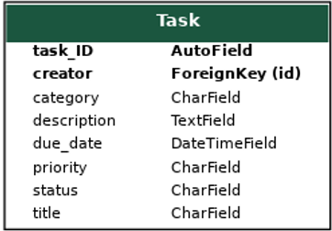
Task Model

Slide 16
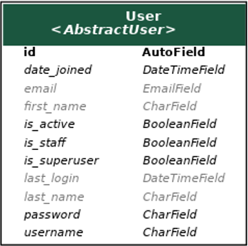
User Model

Slide 17
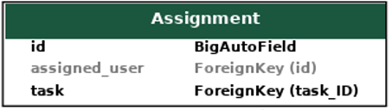
Assignment Model

Slide 18
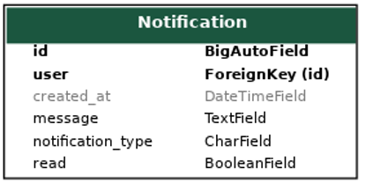
Notification Model

Slide 19

Implementation

Slide 20

Testing

Slide 21
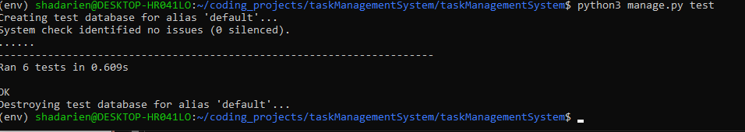
Testing via TestCase
Django’s built-in testcase allows easier testing for a projects model.
Testing can be performed by navigating to the project folder and running “python3 manage.py test”

Slide 22

HOSTING

Slide 23
Hosting
Hosting can be completed via docker or any cloud hosted platform that supports python environments.
Currently, this project is hosted locally and requires networking infrastructure knowledge for further presentation

Slide 24

CONCLUSION

Slide 25
Conclusion
This is my Task Management System that allows users to organize, prioritize, and track their tasks efficiently via helping individuals and teams manage their workflows by providing features such as task creation, categorization, due dates, priority levels, and status tracking.

Slide 26
REFERENCES
Python 3.x: For backend logic and database interactions.
Django ORM: For managing database operations.
HTML5/CSS3: For creating the user interface.
JavaScript: For enhancing interactivity and handling client-side logic.

Slide 27

QUESTIONS

